Slide 1
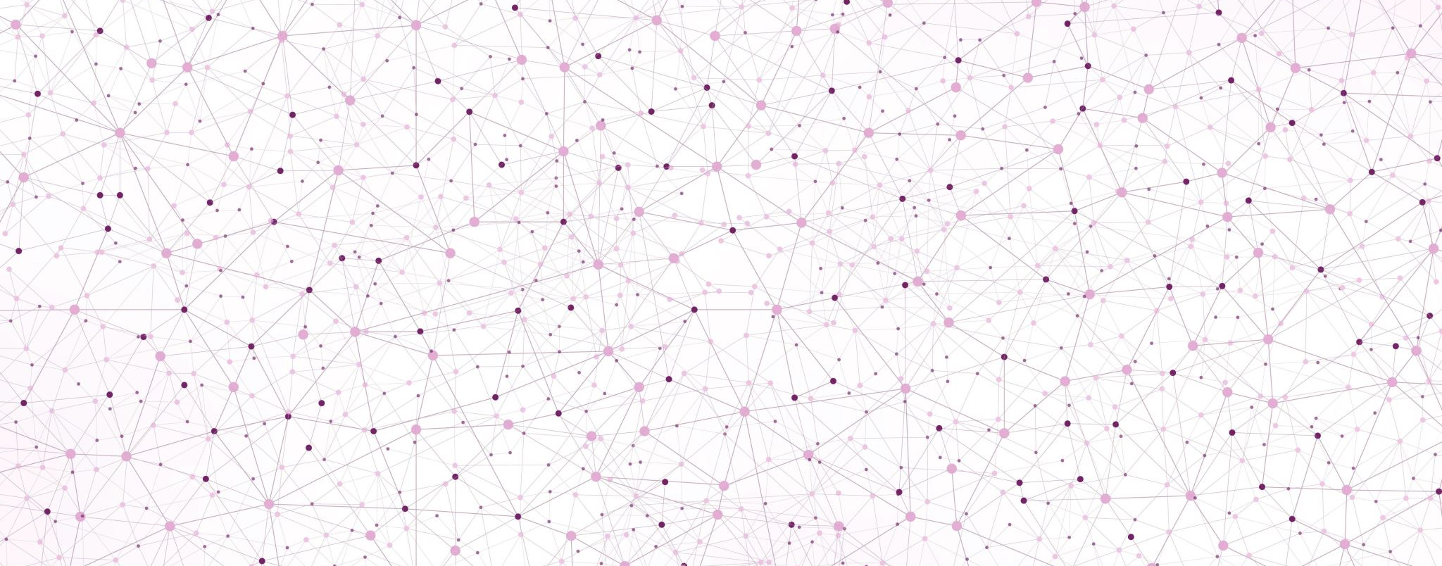
Foundations and Frontiers: Introduction to Machine Learning (ML) for Interdisciplinary Research

Slide 2
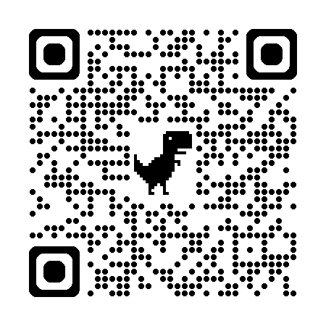
Presenter:
Thanh Tran, PhD candidate in Machine Learning, EAIT
Experienced in machine learning engineering, data science, and research
Specialize in advanced neural networks for traffic management
Enjoy learning about AI, data science

Slide 3
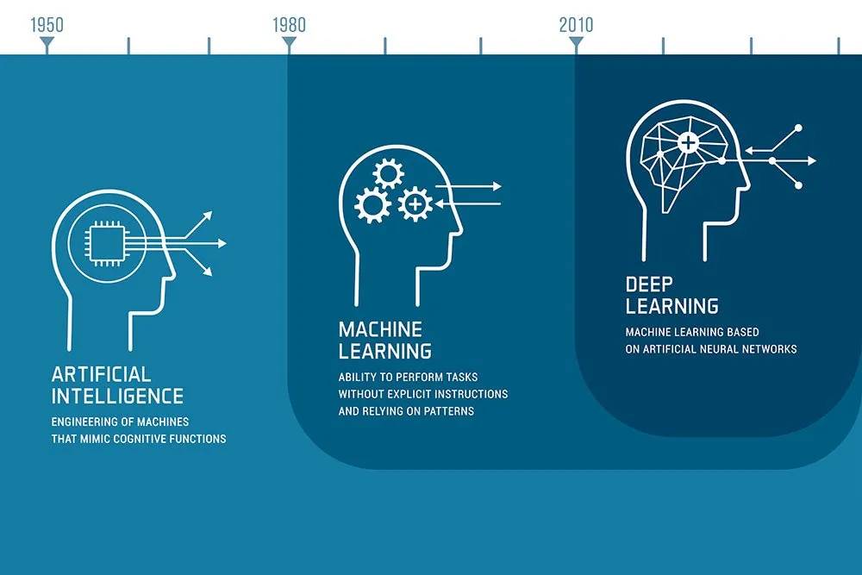
Understanding the Impact of Machine Learning
Infographic explaining artificial intelligence, machine learning and deep learning. Credit: elenabs/iStock.com

Slide 4
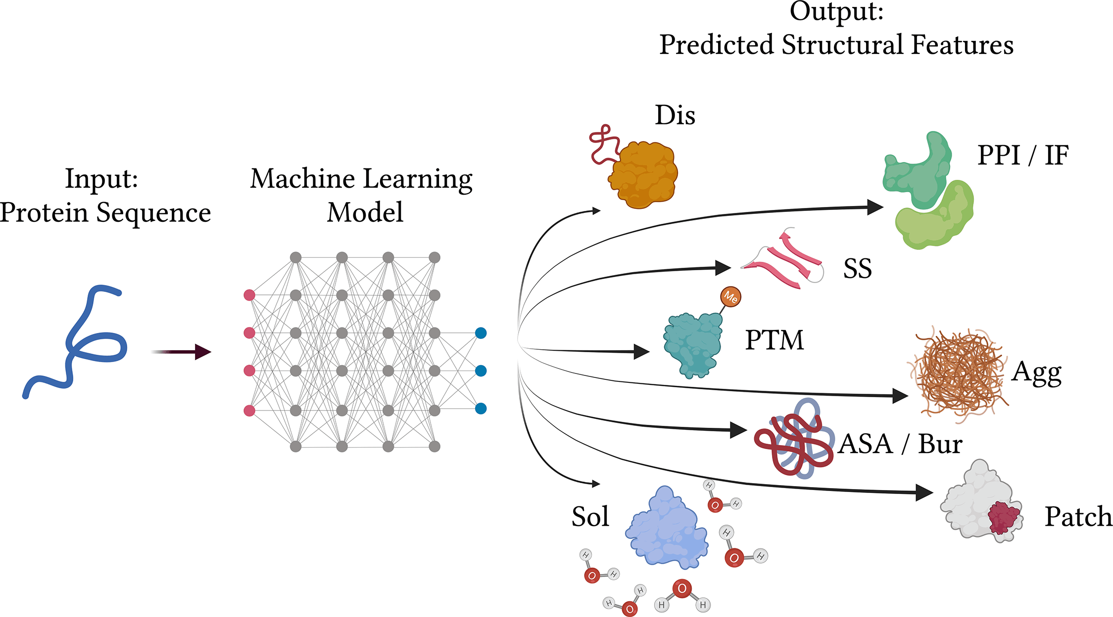
Some Applications of Machine Learning
https://cbirt.net/ten-hacks-for-predicting-protein-properties-from-sequences-using-machine-learning/

Slide 5
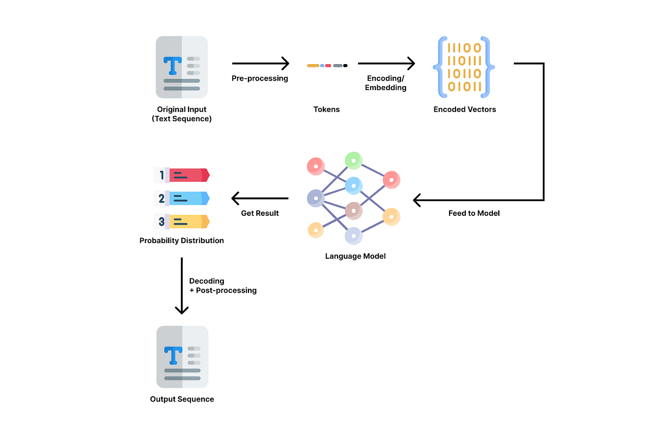
Some Applications of Machine Learning
https://bootcamp.uxdesign.cc/how-chatgpt-really-works-explained-for-non-technical-people-71efb078a5c9

Slide 6
Machine Learning Tools
TensorFlow – a popular tool that offers easy model development using high-level APIs, support for parallel neural network training, and extensive community support
PyTorch – a tool used in the development of machine learning applications for creating deep models, productizing them, and training them
Scikit-Learn – an open-source Python library that offers a variety of machine learning algorithms, pre-processing techniques, cross-validation, and visualization methods
Google TensorFlow – a popular open-source machine learning framework developed by Google

Slide 7
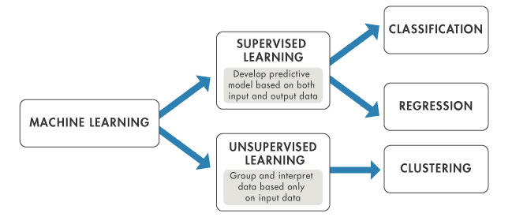
Types of ML
https://www.datacamp.com/blog/what-is-machine-learning

Slide 8
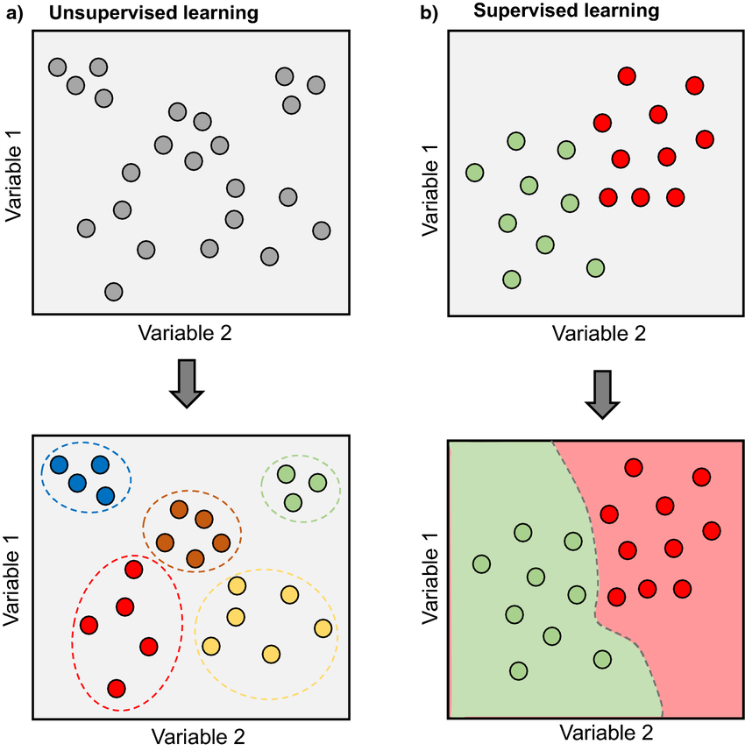
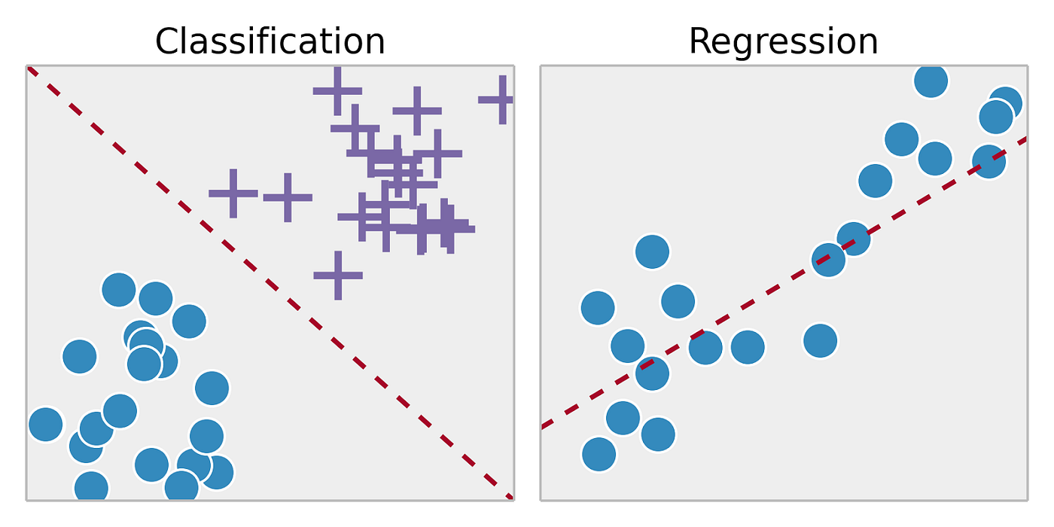
Common types of ML
https://towardsdatascience.com/supervised-vs-unsupervised-learning-14f68e32ea8d
https://www.researchgate.net/figure/Supervised-and-unsupervised-machine-learning-a-Schematic-representation-of-an_fig3_351953193

Slide 9
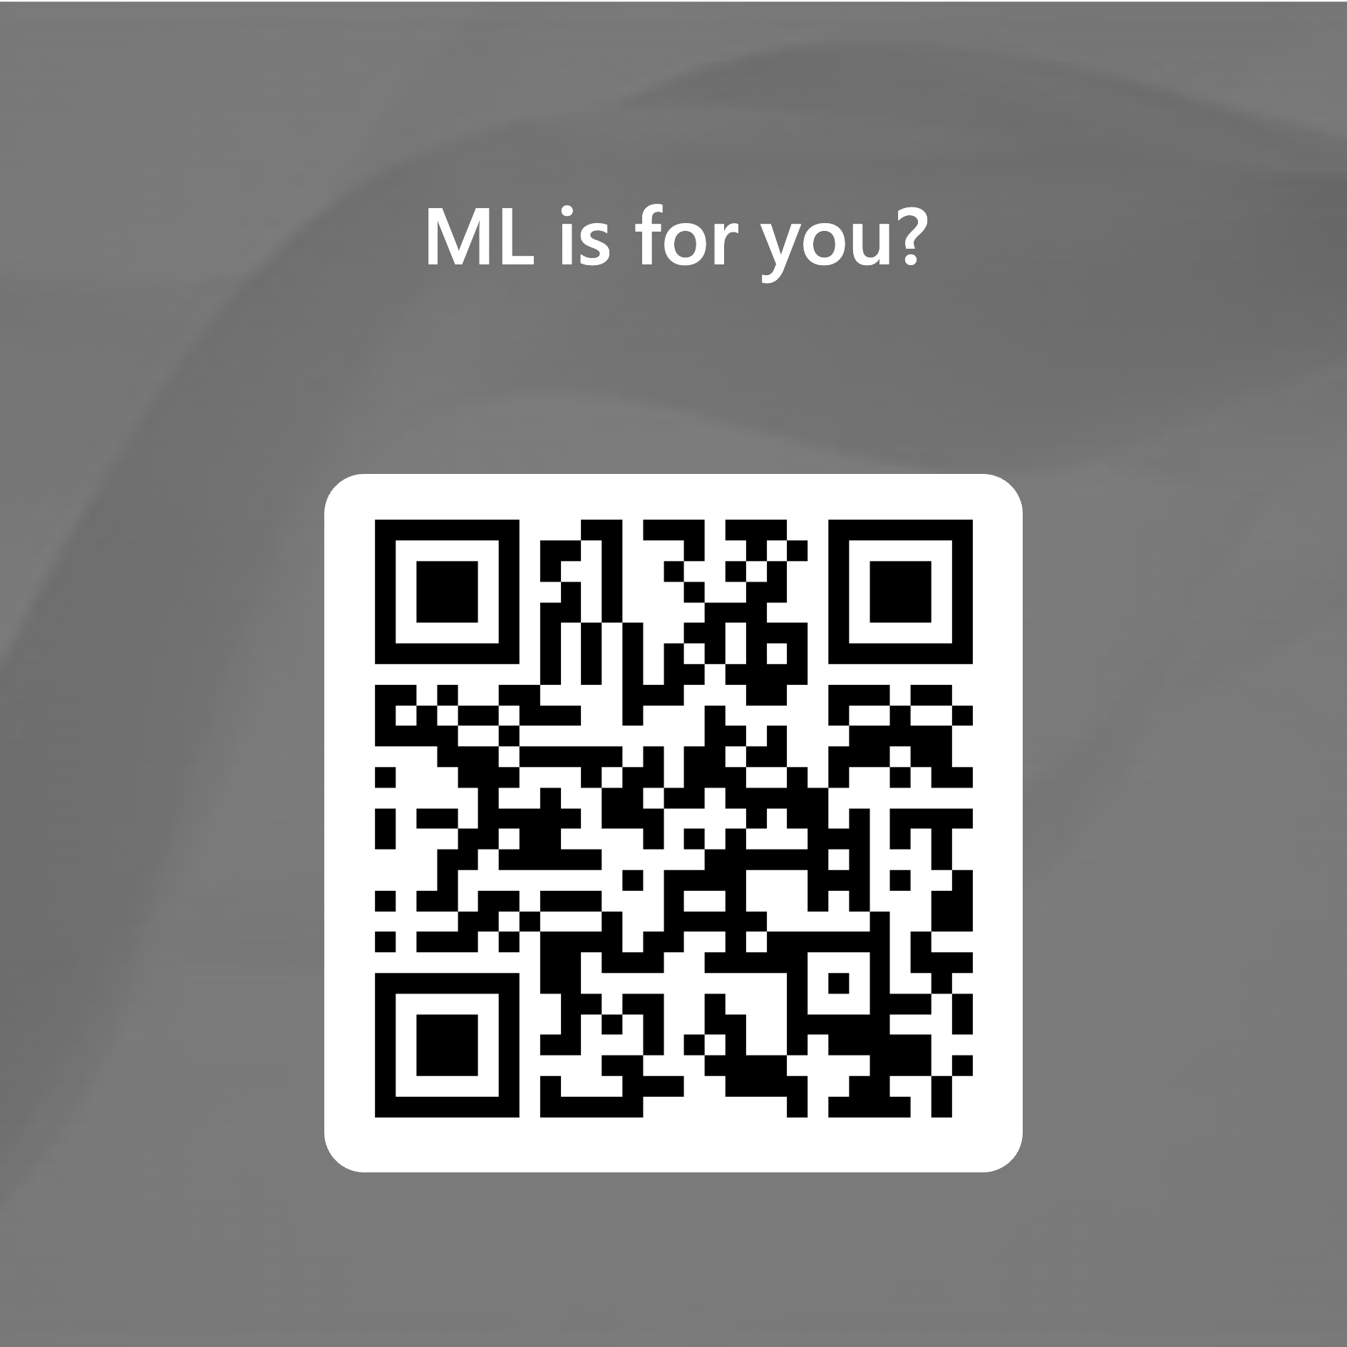
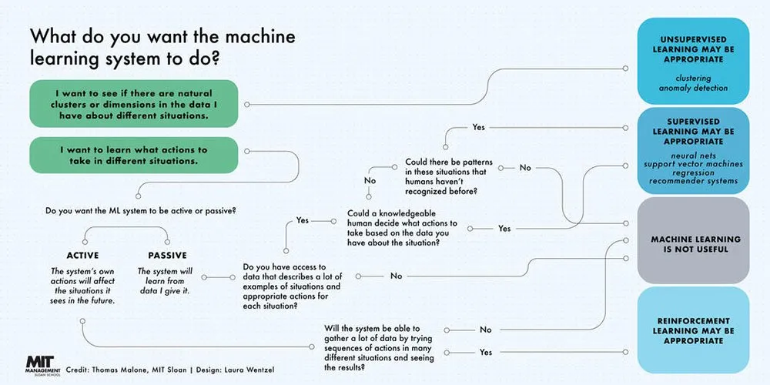
Machine Learning Models in Action
Training (Supervised) of machine learning models involves the use of an initial dataset, guiding the models to identify certain patterns or perform specific tasks.
One such machine learning model for prediction could be any of the following commonly utilized models:
Linear regression
K-nearest neighbors
https://forms.office.com/r/TaBFqQMuEi
Image Source: https://mitsloan.mit.edu/ideas-made-to-matter/machine-learning-explained

Slide 10
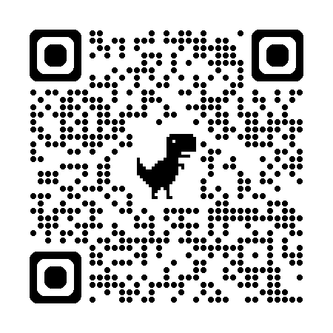
Context:
You are conducting research in a variety of fields and want to determine if machine learning (ML) techniques are applicable to your work. Based on the decision flowchart provided by MIT Sloan, answer the following questions by choosing the most appropriate machine learning approach or determining if machine learning is not useful.
Team based activity
Answer; https://shorturl.at/nULxq
https://forms.office.com/r/TaBFqQMuEi

Slide 11
Machine Learning, Unsupervised Learning Algorithm, Clustering with Kmean
Foundations and Frontiers: Introduction to Machine Learning (ML) for Interdisciplinary Research| 29th May 2024
https://www.codecademy.com/learn/machine-learning-clustering-with-k-means/modules/ml-kmeans-clustering-course/cheatsheet

Slide 12
Machine Learning, Unsupervised Learning Algorithm, Clustering with Kmean
https://www.datacamp.com/tutorial/cluster-analysis-in-tableau
Foundations and Frontiers: Introduction to Machine Learning (ML) for Interdisciplinary Research| 29th May 2024

Slide 13
Machine Learning, Unsupervised Learning Algorithm, Clustering with Kmean
https://www.linkedin.com/pulse/k-means-clustering-use-cases-kartik-lokare-1f
Foundations and Frontiers: Introduction to Machine Learning (ML) for Interdisciplinary Research| 29th May 2024

Slide 14
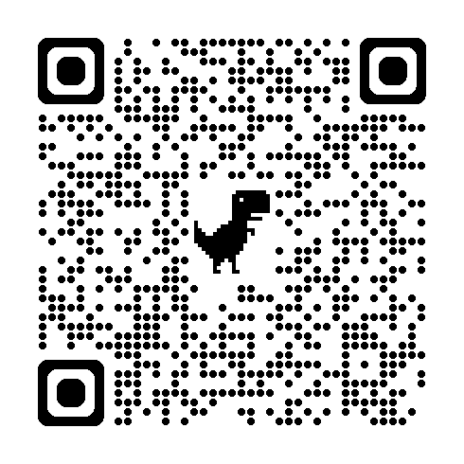
Exercise with different datasets
https://shorturl.at/tVPsl

Slide 15
Upcoming Events and Notifications
Statistics Network
Statistics with Python Seminar
Student Staff Partnership
Online resources
Library training

Slide 16


Slide 17
Question 1:
You are researching consumer behavior patterns to identify potential market segments. You have a large dataset of consumer purchases, demographics, and browsing history.
What do you want the machine learning system to do?
A) Identify natural clusters or dimensions in the data.
B) Learn what actions to take in different situations.
What type of learning is appropriate?
Unsupervised Learning
Supervised Learning
Machine Learning is not useful
Image Source: https://mitsloan.mit.edu/ideas-made-to-matter/machine-learning-explained
Notes:
Answer:
What do you want the machine learning system to do?
A) Identify natural clusters or dimensions in the data.
Type of learning: 1. Unsupervised Learning

Slide 18
Question 2:
You are studying the impact of climate change on agricultural yield. Your data includes temperature, rainfall, soil quality, and crop yield over the past 50 years.
What do you want the machine learning system to do?
Identify natural clusters or dimensions in the data.
B) Learn what actions to take in different situations.
Could a knowledgeable human decide what actions to take based on the data you have about the situation?
Yes
No
What type of learning is appropriate?
Unsupervised Learning
Supervised Learning
Machine Learning is not useful
Image Source: https://mitsloan.mit.edu/ideas-made-to-matter/machine-learning-explained
Notes:
Answer:
What do you want the machine learning system to do? Learn what actions to take in different situations.
Could a knowledgeable human decide what actions to take based on the data you have about the situation? Yes
Type of learning: 2. Supervised Learning

Slide 19
Question 3:
Context: You are working on a healthcare project where you have patient data, including medical history, treatment plans, and outcomes. You want to predict the most effective treatment for new patients based on their medical history.
What do you want the machine learning system to do?
A) Identify natural clusters or dimensions in the data.
B) Learn what actions to take in different situations.
What type of learning is appropriate?
Unsupervised Learning
Supervised Learning
Machine Learning is not useful
Image Source: https://mitsloan.mit.edu/ideas-made-to-matter/machine-learning-explained
Notes:
Answer:
B) Learn what actions to take in different situations.
Supervised Learning

Slide 20
Question 3:
Context: You are working on a healthcare project where you have patient data, including medical history, treatment plans, and outcomes. You want to predict the most effective treatment for new patients based on their medical history.
What do you want the machine learning system to do?
A) Identify natural clusters or dimensions in the data.
B) Learn what actions to take in different situations.
What type of learning is appropriate?
Unsupervised Learning
Supervised Learning
Machine Learning is not useful
Image Source: https://mitsloan.mit.edu/ideas-made-to-matter/machine-learning-explained
Notes:
Answer:
B) Learn what actions to take in different situations.
Supervised Learning

